Slide 1

MOSSE CORRELATION FILTER
Sofya Torosyan

Slide 2
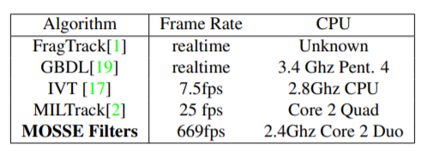
Visual Tracking
Visual tracking has many applications in video processing. When target is located in one frame it's useful to track it in subsequent frames to get more information about object.
Naïve methods produce strong peaks for target, but falsely respond to the background. In contrast correlation filters are more robust to changes and discriminate between target and background.

Slide 3
Definition of terms
Object/Target: Physical entity to be tracked
Template: Sub-image cropped from an initial image. Template is used to initialize the filter.
Correlation: Measure of similarity between 2 images: Sum of pairwise product of corresponding pixels of 2 images. Template matching uses correlation of template and an image to find location of the object.
Filter: Sub-image. Filtering is the process of placing the filter over the image at different locations and computing pairwise sum of the filter and corresponding image pixels.
Tracking window: Sub-image where new location of the object is searched. Tracking windows correlates with the filter for getting new location.
Initialization: Process, where the filter for tracking an object in the video is generated. Initialization is also referred as training.
Updating: Process, where a filter is updated with the new information about the object(change in the pose of the person)
Synthetic target: Synthetically generated image with a Gaussian peak at the location of the object to be tracked. Is used to map the input image to its corresponding correlation output to generate a filter.

Slide 4
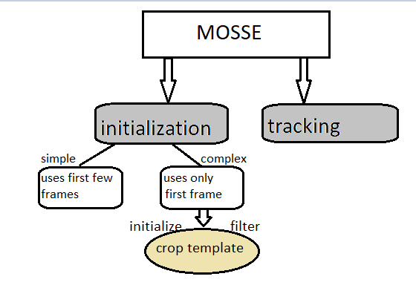
MOSSE tracking algorithm
MOSSE: Minimum output sum of squared errors
Developed by David Blome, a PHD student and computer vision group.
Preprocessing step
Cropped template is converted to Fourier domain
Synthetic output is created, converted to Fourier domain
Filter is computed in Fourier domain
Correlation output is converted to spatial domain
New position of the object in next frames is found
Visual Object Tracking using Adaptive Correlation Filters

Slide 5
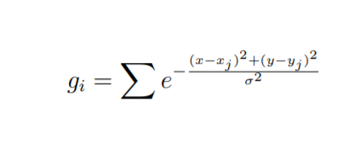
Synthetic target
Synthetic target is a synthetically generated desired correlation output.
Synthetic target image contains Gaussian peak centered on the object center.
Is used for initialization of the filter and for updating filter during tracking.
gi : synthetic target
sigma: radius of the peak
x,y: locations of pixels in the image
xj, yj : locations of the center of the image

Slide 6

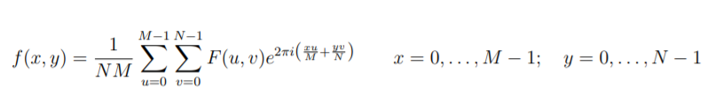
Preprocessing
Template which contains object in the center, is cropped.
Template is converted to gray scale image.
Log transformation is performed on the template to reduce ligthting effects and make high contarst features available
x = ln(y + 1)
Pixel values are normalized to reduce effects of change in illumination
Template is converted to frequency domain using Discrete Fouirer transformation.

Slide 7
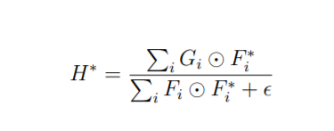
MOSSE filter
H*: complex conjugate of the filter
Fi : cropped template in fourier domain for the ith frame
Gi : synthetic target in Fourier domain for ith frame
F*i : complex conjugate of Fi
Epsilion: regularization parameter to avoide divide by zero errors.

Slide 8


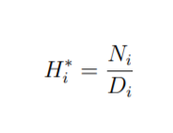
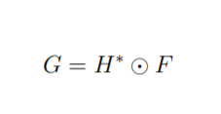
MOSSE tracker
η : learning rate (0,1)
When filter is initialized, current frame becomes next frame
Tracking window is cropped from the current frame
using centered position of the object from the previous step
The tracking window is preprocessed and transformed to the Fourier domain.
The tracking window is then multiplied with the filter to get
the new position of the object in the current frame
This multiplication results in Gaussian peak, which shows new location of the object.

Slide 9
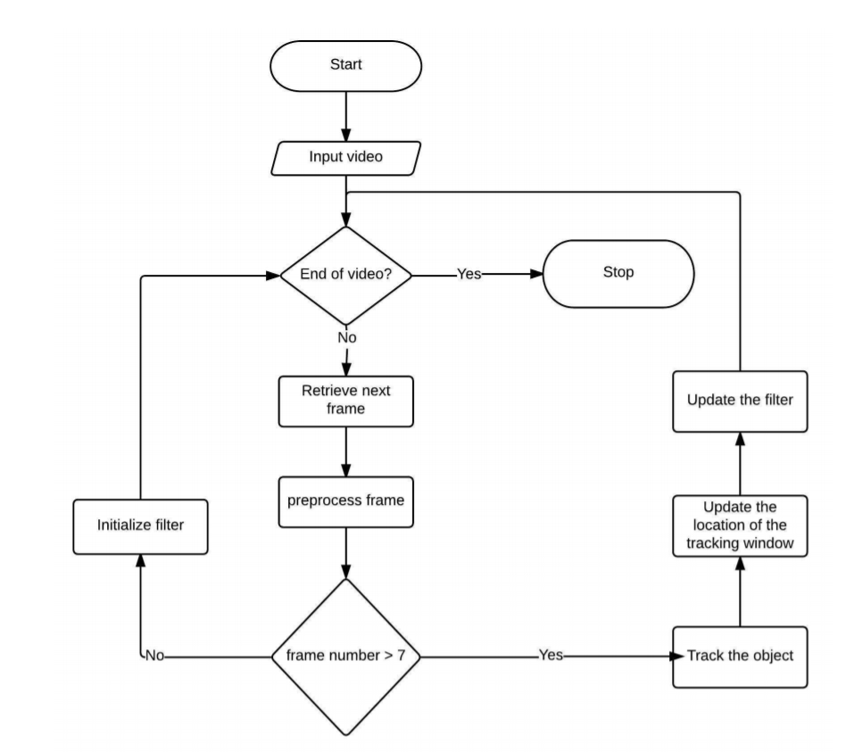
MOSSE flow chart

Slide 10
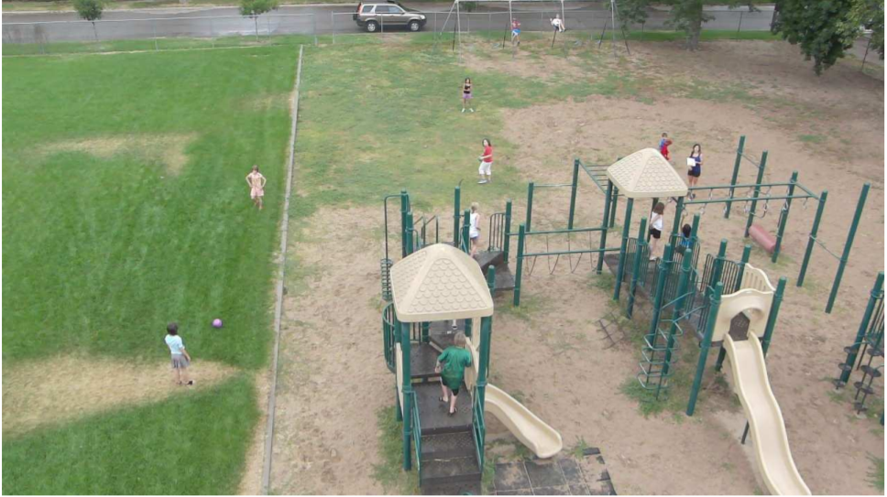
MOSSE filter

Slide 11
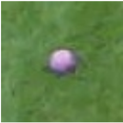
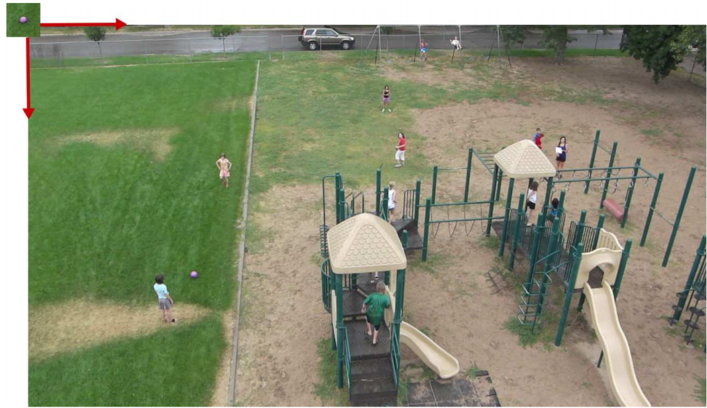
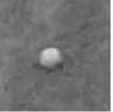
MOSSE filter

Slide 12
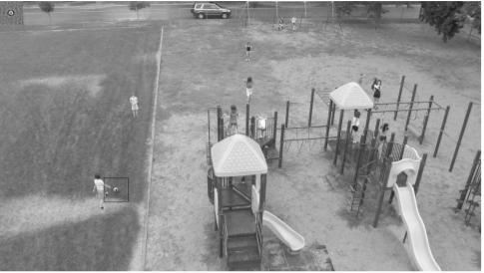
MOSSE filter

Slide 13
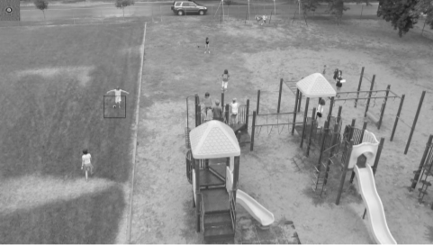
MOSSE filter

Slide 14
References
Visual Object Tracking using Adaptive Correlation Filters by David S. Bolme J. Ross Beveridge Bruce A. Draper Yui Man Lui
Tutorial on Minimum Output Sum of Squared Error Filter by Rumpal Kaur Sidhu

Slide 15


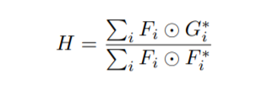

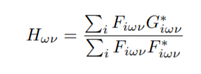
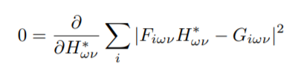

MOSSE minimization – more math

Slide 16
THANK YOU!

